Slide 1
DDC112 Electrometer
13 Feb 2013
D. Peterson

Slide 2
DDC112 Internals

Slide 3
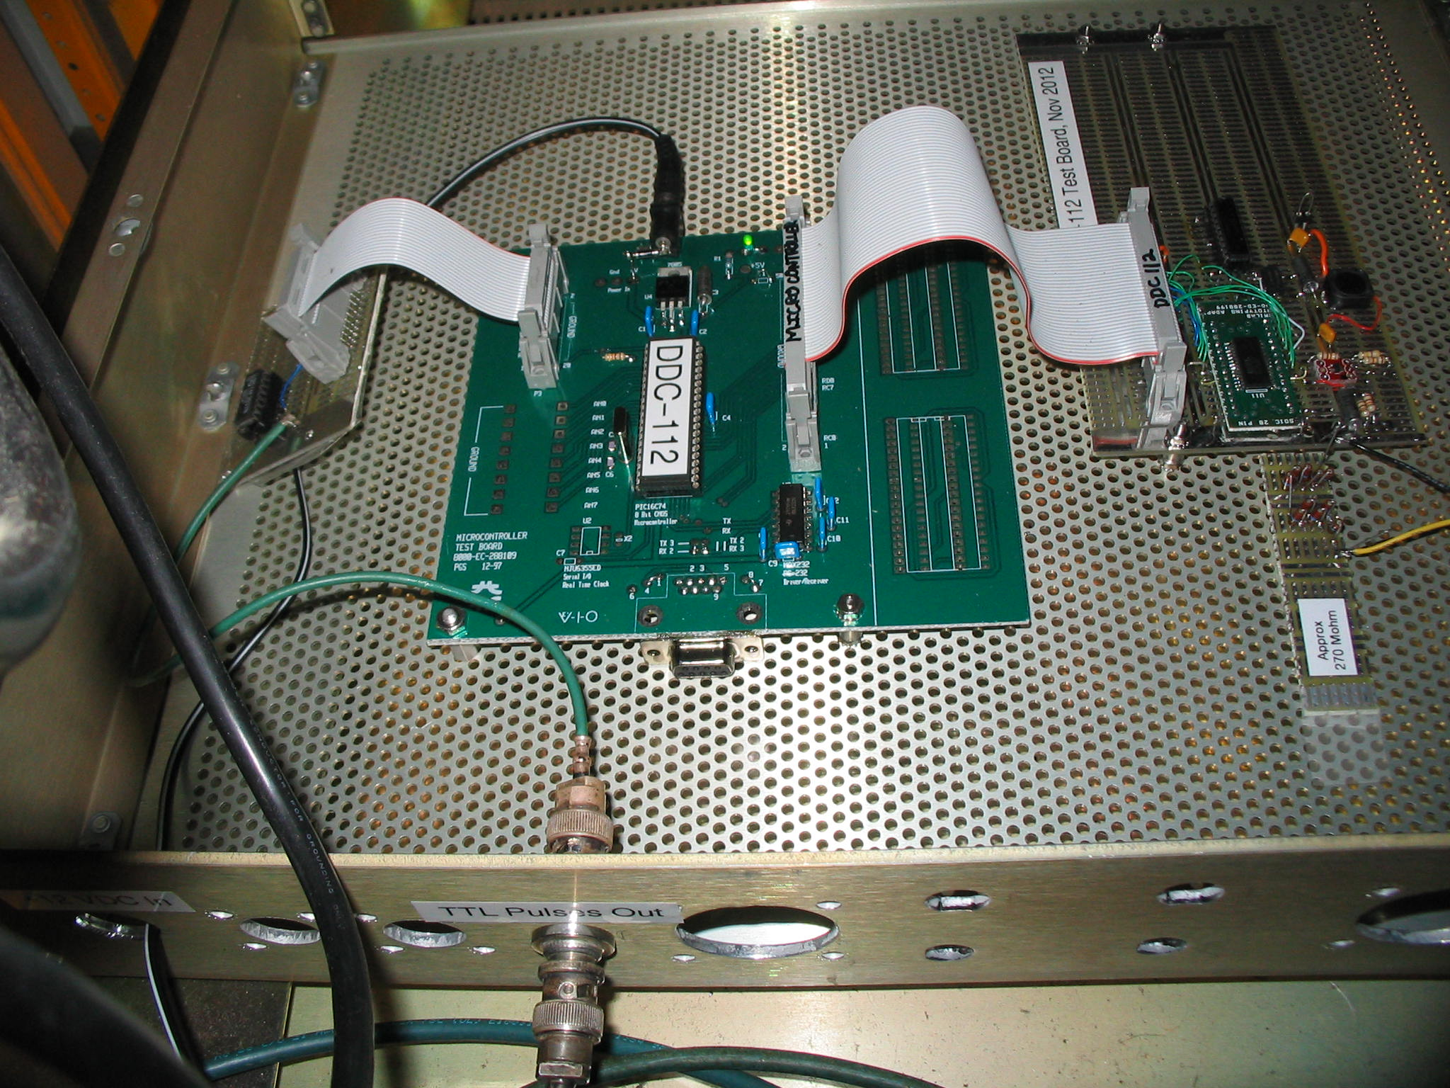

Slide 4
DDC112 Implementation
Pulse out every 1nC.
Full scale internal reading is 350 pC in 20 bits.
Cycle time is about 600 uS.
Max input rate is 583 nA.
Max output rate is 70 pulses/sec * 1nC/pulse = 70 nA.
32 bit accumulator of 20 bit values. Saturates at about 1.43 uC. Takes about 20 sec to dump that at 70 Hz.

